Slide 1
Anime List
Samson Adeyinka

Slide 2
Content
The Idea
CI Pipeline
ERD
The Application
Conclusion
Questions?

Slide 3
The idea…
My idea was to create an Anime list application for users to keep track of Anime shows they are currently watching and Anime shows they have completed.

Slide 4





CI Pipeline…

Slide 5
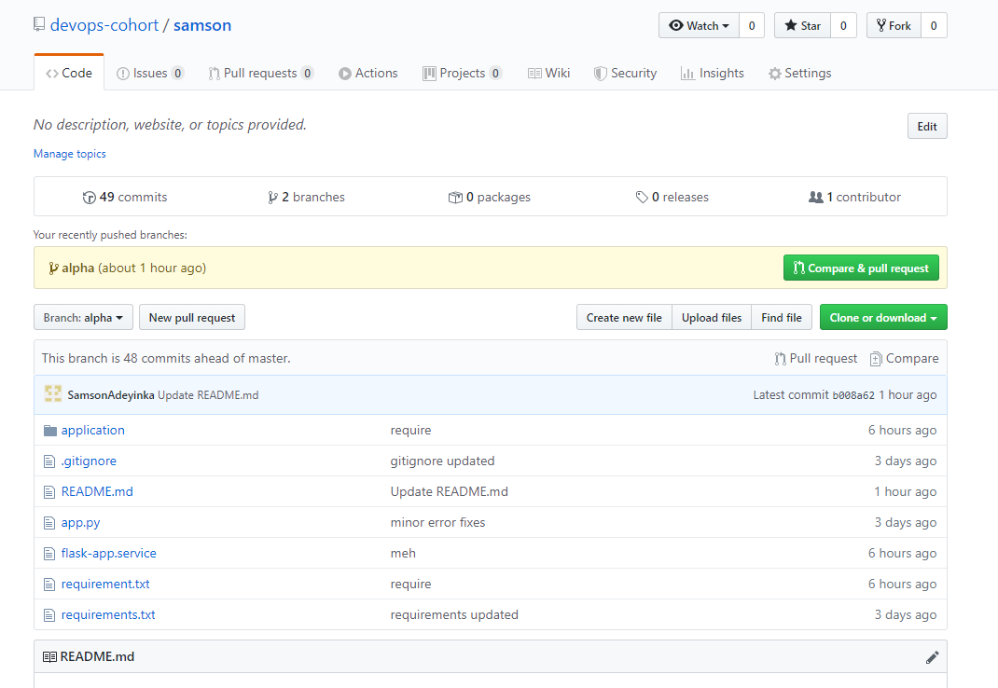
Git…

Slide 6
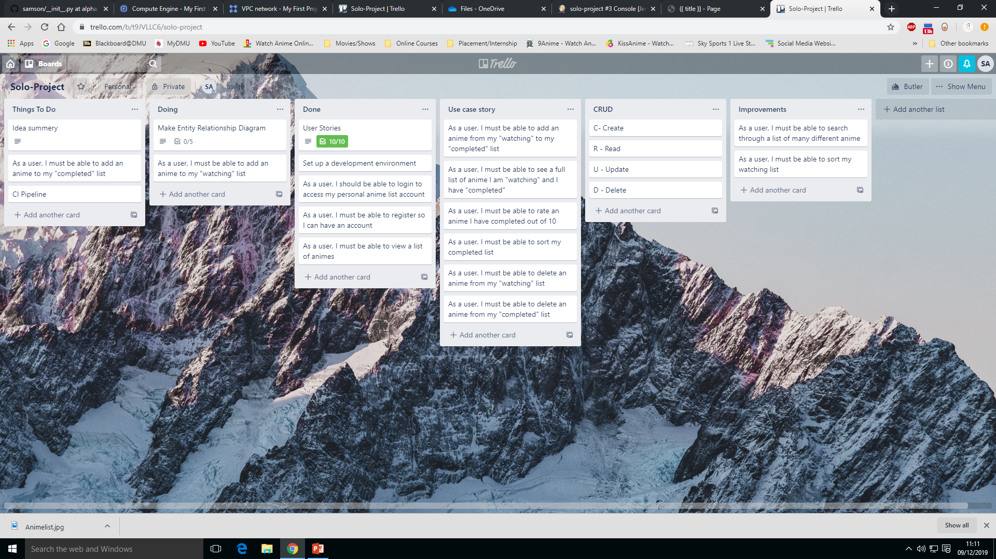
Trello…

Slide 7
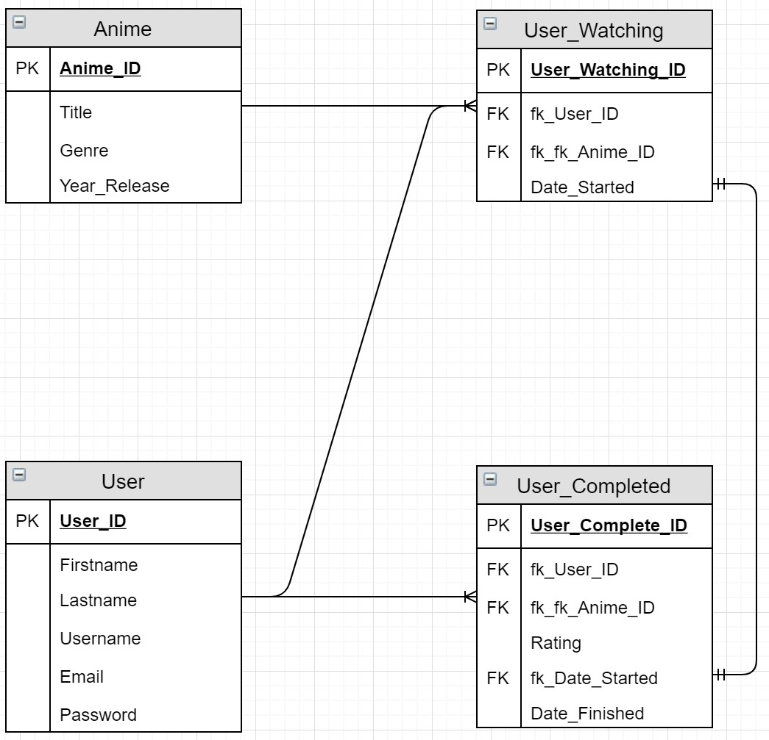
ERD…

Slide 8
Live Demo…
http://35.228.204.140:5000/login

Slide 9
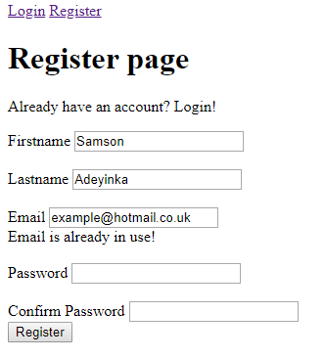
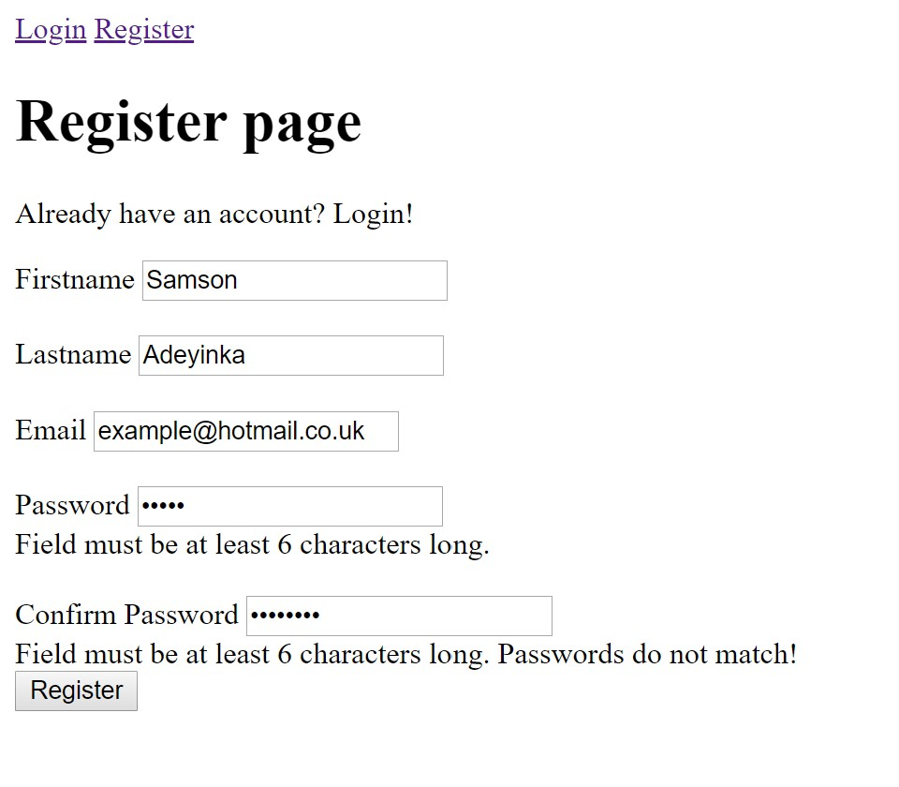
The App…

Slide 10
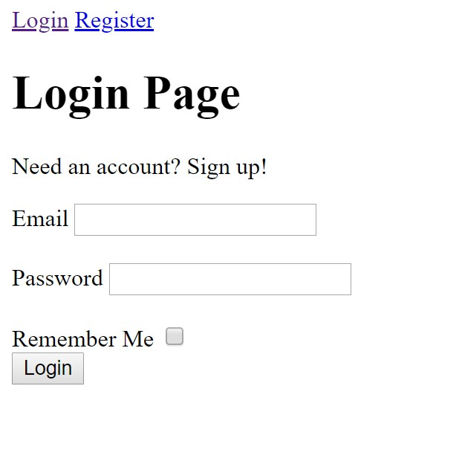
The App..
The login page will allow the user Login into their account with their credentials

Slide 11
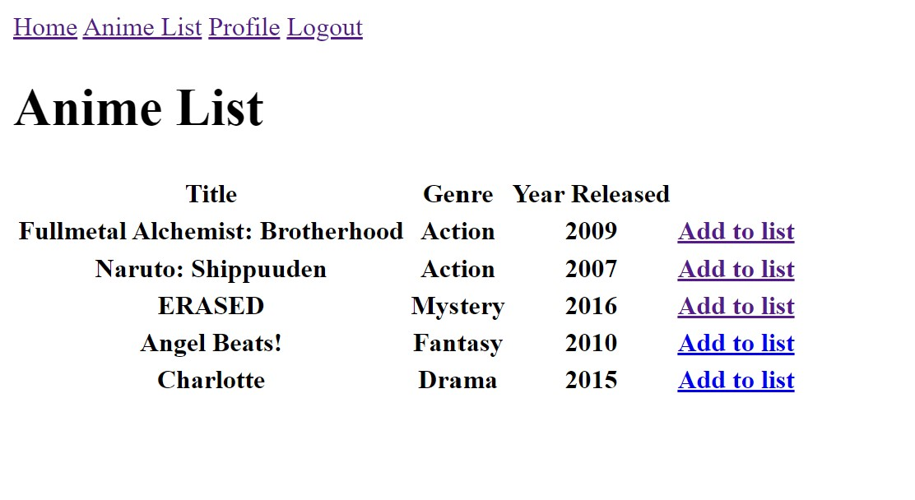
The App…
This page is list of anime shows from the database where user can Add the anime to their watch list

Slide 12
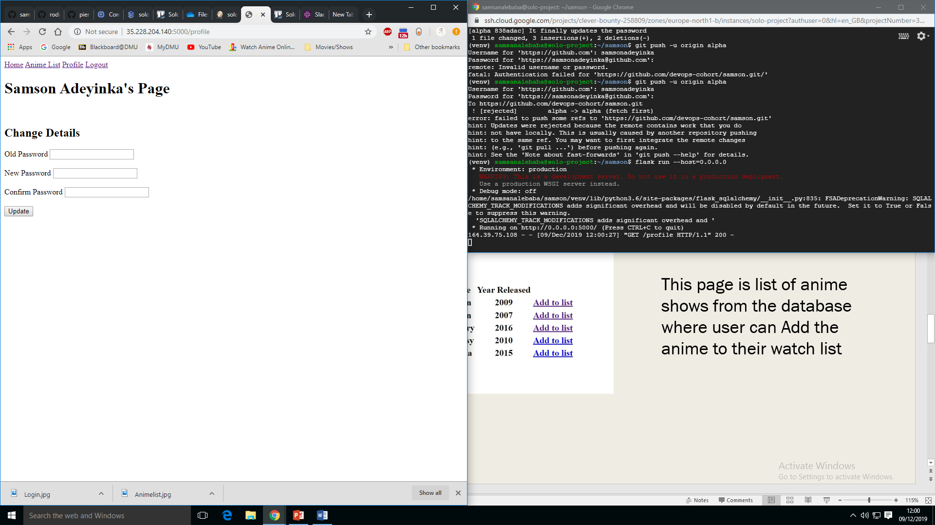
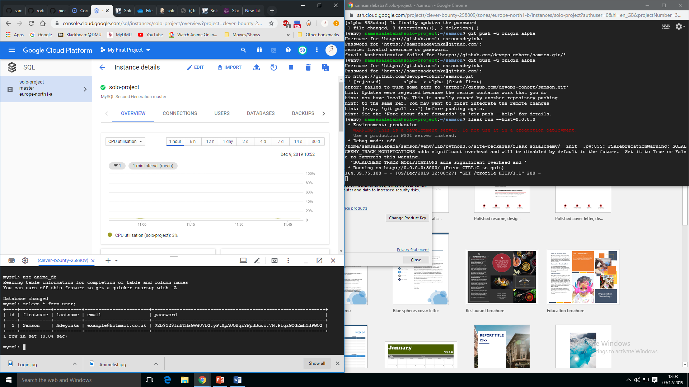
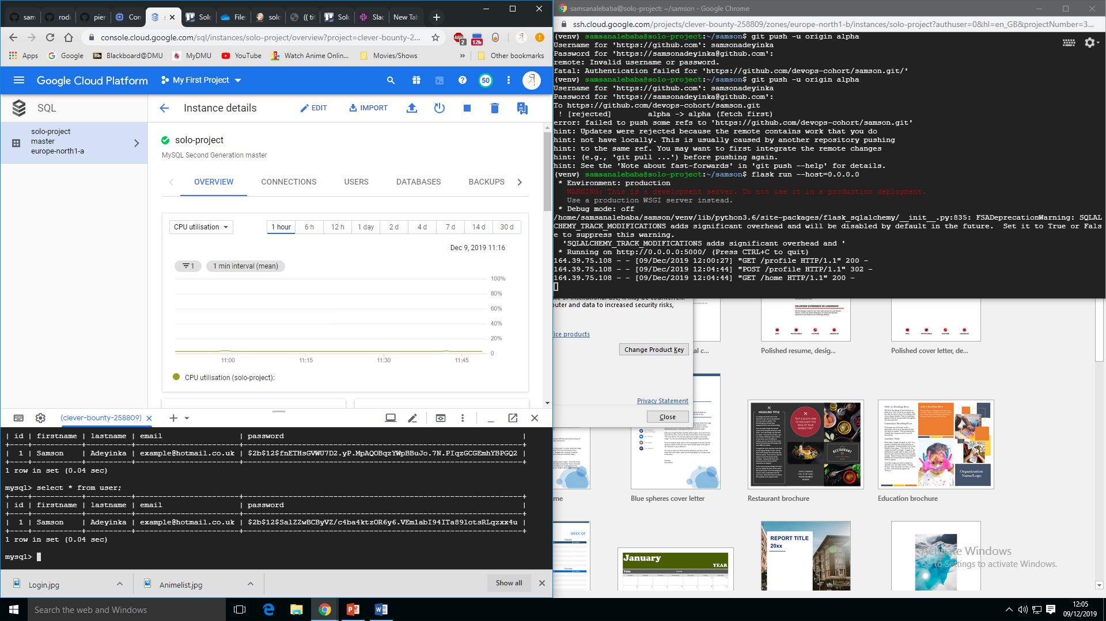
The App…
This changes the password of the user

Slide 13
Future Improvements
CSS/Design
User interface
Search bar - Search through the anime list to find a specific anime
Admin User
Add and Edit to the list of anime available

Slide 14
What went wrong?
Time
Coding Error
Implementation
Testing

Slide 15
Conclusion
CRUD?
The Application
Personal Improvements?
What will I do next?

Slide 16
Questions?

